Slide 1

Varendra University
Dept. of Computer Science & Engineering (CSE)
Lab 2
Course Title: Microprocessor and Assembly Language Lab
Course No: CSE 3206
Prepared By:
Md. Adnan Sami
Lecturer, Dept. of CSE, VU

Slide 2
Experiment No: 02
Name of the Experiment:
Write an assembly language program to print a string using EMU8086.
Write an assembly language program to add two numbers using EMU8086.
Write an assembly language program to subtract two numbers using EMU8086.

Slide 3
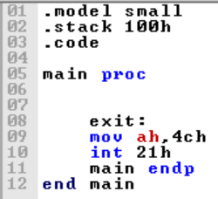
Return

Slide 4
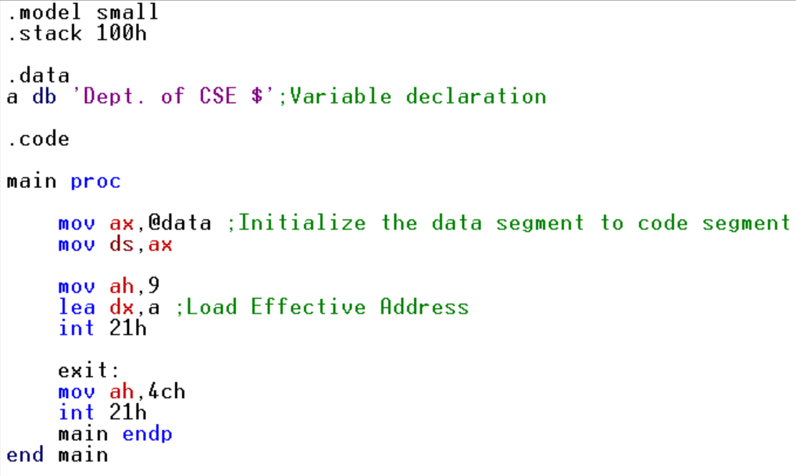
i. Write an assembly language program to print a string using EMU8086.

Slide 5
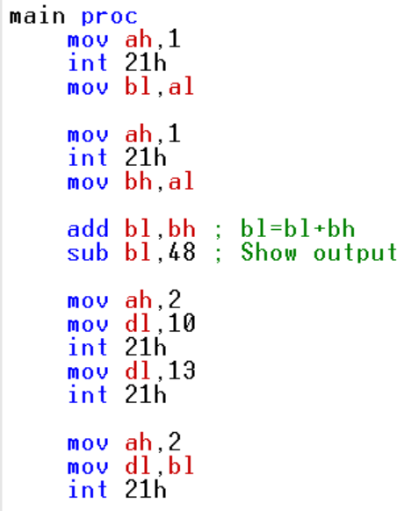
ii. Write an assembly language program to add two numbers using EMU8086.

Slide 6
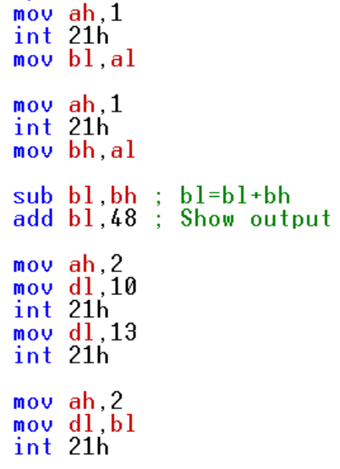
iii. Write an assembly language program to subtract two numbers using EMU8086.

